Slide 1
The t Test For
Two Independent Samples
Adapted
Chapter 10

Slide 2
Independent Samples t-test
Adapted from:
Statistics for the Behavioral Sciences (10 e, Gravetter and Wallbau, 2017)

Slide 3
Independent-Measures Designs
The research designs that are used to obtain the two sets of data can be classified in two general categories:
  The two sets of data could come from two completely separate groups of participants.
  The two sets of data could come from the same group of participants.
The first research strategy, using completely separate groups, is called an independent- measures or a between-subjects design.

Slide 4
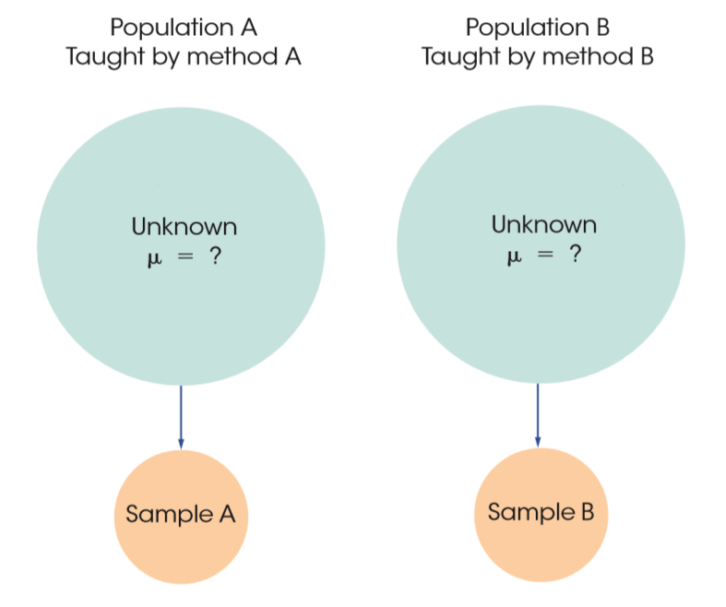
An Independent-Measures Research Study
Notes:
Figure 10.1
The structure of an independent-measures research study. Two separate samples are used to obtain information about two unknown populations or treatment conditions.

Slide 5
The Null Hypothesis and the Independent-Measures t Statistic
The goal of an independent-measures research study is to evaluate the mean difference between two populations (or between two treatment conditions).
  Using subscripts to differentiate the two populations, the mean for the first population is µ₁, and the second population mean is µ₂.
  The difference between means is simply µ₁ − µ₂.
  As always, the null hypothesis states that there is no change, no effect, or no difference.

Slide 6
The Null Hypothesis (cont’d.)
The null hypothesis for the independent-measures test:
    H₀: µ₁ − µ₂ = 0
    (No difference between the population means)
The alternative hypothesis states that there is a mean difference between the two populations:
    H₁: µ₁ − µ₂ ≠ 0
    (There is a mean difference.)
  The alternative hypothesis can simply state that the two population means are not equal: µ1 ≠ µ2.

Slide 7
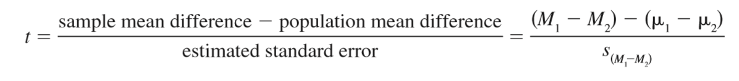
The Formulas for an Independent-Measures Hypothesis Test
The independent-measures t uses the difference between two sample means to evaluate a hypothesis about the difference between two population means. Thus, the independent- measures t formula is:

Slide 8
The Formulas for an Independent-Measures Hypothesis Test (cont’d.)
In each of the t-score formulas, the standard error in the denominator measures how accurately the sample statistic represents the population parameter.
  In the single-sample t formula, the standard error measures the amount of error expected for a sample mean and is represented by s_{M}.

Slide 9
The Formulas for an Independent-Measures Hypothesis Test (cont’d.)
  For the independent-measures t formula, the standard error measures the amount of error that is expected when you use a sample mean difference (M₁ − M₂) to represent a population mean difference (µ₁ − µ₂).
    The standard error for the sample mean difference is represented by the symbol s_{(M1-M2)}.

Slide 10
The Formulas for an Independent-Measures Hypothesis Test (cont’d.)
The estimated standard error of M₁ − M₂ can be interpreted in two ways.
  First, the standard error is defined as a measure of the standard or average distance between a sample statistic (M₁ − M₂) and the corresponding population parameter (µ₁ − µ₂).
  When the null hypothesis is true, the standard error is measuring how big, on average, the sample mean difference is.

Slide 11
Calculating the Estimated Standard Error
  To develop the formula for s_{(M1-M2)} we consider three points:
    Each of the two sample means represents it own population mean, but in each case there is some error.
    The amount of error associated with each sample mean is measured by the estimated standard error of M.

Slide 12
Calculating the Estimated Standard Error (cont’d.)
    For the independent-measures t statistic, we want to know the total amount of error involved in using two sample means to approximate two population means.
      To do this, if the samples are the same size, we will find the error from each sample separately and then add the two errors together.
      When the samples are of different sized, a pooled or average estimate, that allows the bigger sample to carry more weight in determining the final value, is used.

Slide 13
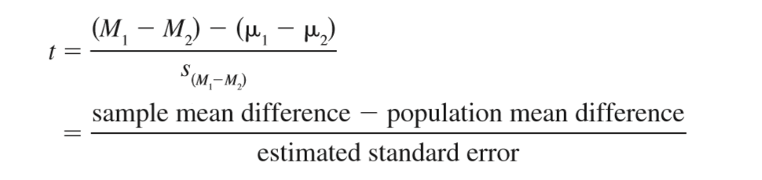
The Final Formula and Degrees of Freedom
  The complete formula for the independent-measures t statistic is as follows:

Slide 14
The Final Formula and Degrees of Freedom (cont’d.)
  The degrees of freedom for the independent-measures t statistic are determined by the df values for the two separate samples:
      df for the t statistic = (n₁ – 1) + (n₂ – 1)
      = n₁ + n₂ - 2

Slide 15
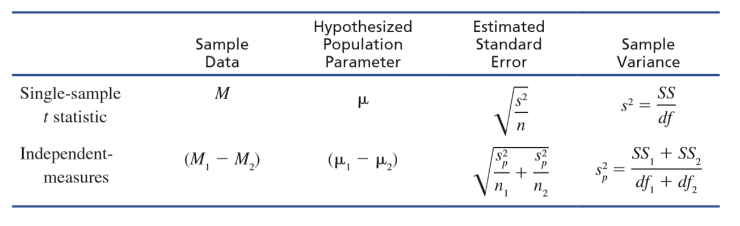
The Basic Elements of a t Statistic
Notes:
TABLE 10.1 The basic elements of a t statistic for the single-sample t and the independent-measures t.

Slide 16
Hypothesis Tests with the Independent-Measures t Statistic
The independent-measures t statistic uses the data from two separate samples to help decide whether there is a significant mean difference between two populations or between two treatment conditions.
  State the hypotheses and select the alpha level.
  Compute the df for an independent-measures design.
  Obtain the data and compute the test statistic.
  Make a decision.

Slide 17
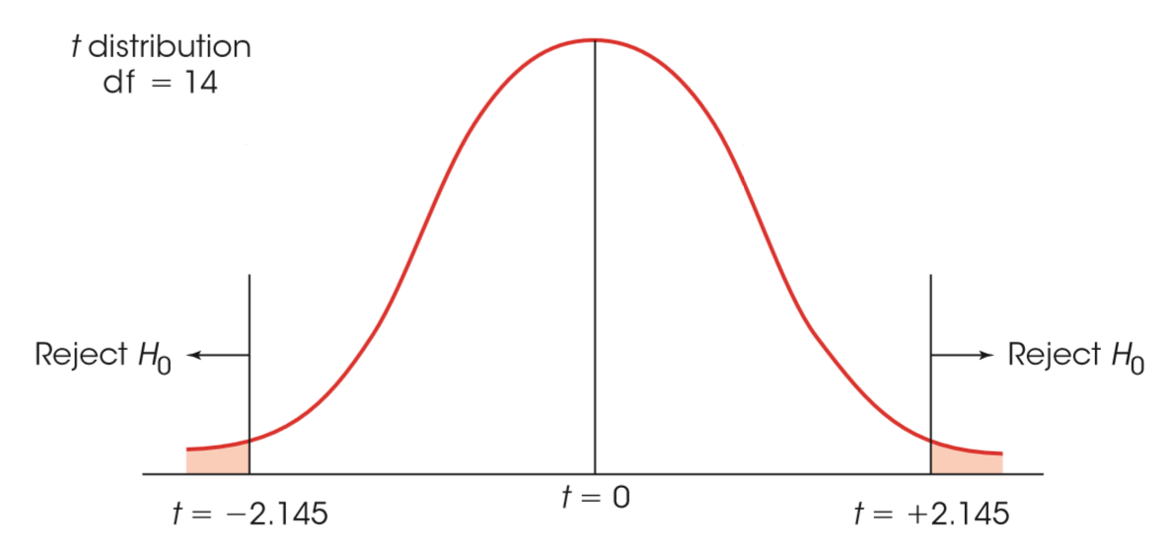
The Critical Region for the Independent–Measures Hypothesis Test
Notes:
FIGURE 10.3 The critical region for the independent–measures hypothesis test.

Slide 18
Assumptions Underlying the Independent-Measures t Formula
Assumptions underlying the independent-measures t formula:
  The observations within each sample must be independent.
  The two populations from which the samples are selected must be normal.
  The two populations from which the samples are selected must have equal variances.

Slide 19
Homogeneity of Variance
The third assumption is referred to as homogeneity of variance and states that the two populations being compared must have the same variance.
  Homogeneity of variance is most important when there is a large discrepancy between the sample sizes.

Slide 20
Hypothesis Tests with the Independent-Measures t Statistic (cont'd.)
Make a decision.
  If the t statistic ratio indicates that the obtained difference between sample means (numerator) is substantially greater than the difference expected by chance (denominator), we reject H₀ and conclude that there is a real mean difference between the two populations or treatments.

Slide 21
Measuring Effect Size for the Independent-Measures t
One technique for measuring effect size is Cohen’s d, which produces a standardized measure of mean difference.
  In the context of an independent-measures research study, the difference between the two sample means (M₁ − M₂) is used as the best estimate of the mean difference between the two populations, and the pooled standard deviation (the square root of the pooled variance) is used to estimate the population standard deviation.

Slide 22
Confidence Intervals
For the independent- measures t, we use a sample mean difference, M₁ − M₂, to estimate the population mean difference, µ₁ − µ₂.
  The first step is to solve the t equation for the unknown parameter. For the independent-measures t statistic, we obtain
  μ₁ - μ₂ = M₁ - M₂ + ts _{(M1-M2)}
  The values for M₁ – M₂ and for s_{(M1-M2)} are obtained from the sample data.

Slide 23
Confidence Intervals (cont’d.)
  Although the value for the t statistic is unknown, we can use the degrees of freedom for the t statistic and the t distribution table to estimate the t value.
  Using the estimated t and the known values from the sample, we can compute the value of µ₁ − µ₂.

Slide 24
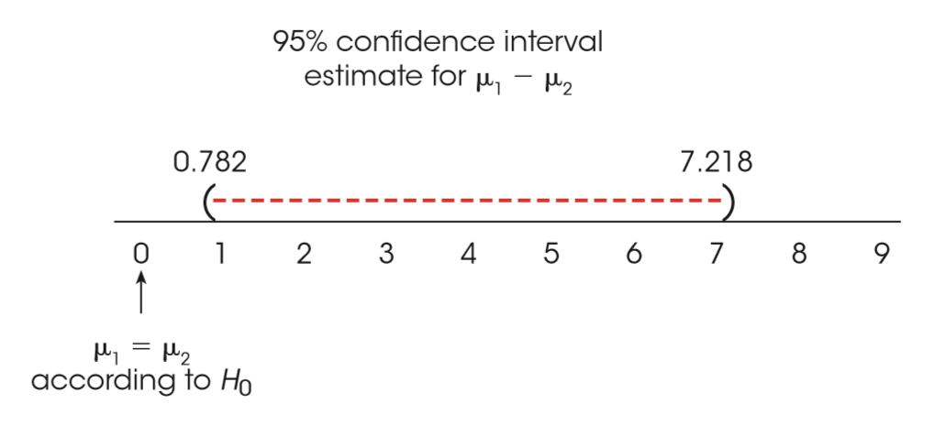
Confidence Intervals and Hypothesis Tests
In addition to describing the size of a treatment effect, estimation can be used to get an indication of the significance of the effect.
Notes:
FIGURE 10.5 The 95% confidence interval for the population mean difference (µ₁ = µ₂). Note that µ₁ - µ₂ = 0 is excluded from the confidence interval, indicating that a zero difference is not an acceptable value (H₀ would be rejected in a hypothesis test with α = .05).

Slide 25
The Role of Sample Variance and Sample Size in the Independent-Measures t Test
Two factors that play important roles in the outcomes of hypothesis tests are the variability of the scores and the size of the samples.
  Both factors influence the magnitude of the estimated standard error in the denominator of the t statistic.

Slide 26
The Role of Sample Variance and Sample Size in the Independent-Measures t Test (cont’d.)
  The standard error is directly related to sample variance so that larger variance leads to larger error.
    As a result, larger variance produces a smaller value for the t statistic (closer to zero) and reduces the likelihood of finding a significant result.
  By contrast, the standard error is inversely related to sample size (larger size leads to smaller error).
    Thus, a larger sample produces a larger value for the t statistic (farther from zero) and increases the likelihood of rejecting H₀.

Slide 27
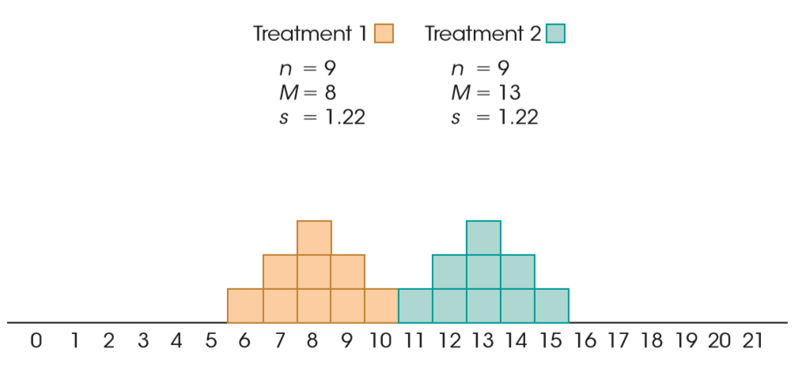
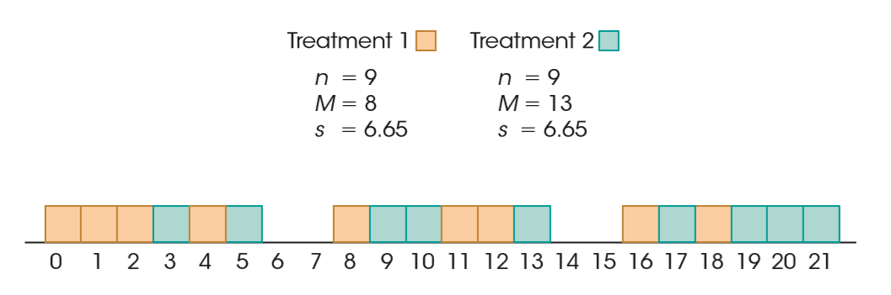
Two Sample Distributions Representing Two Different Treatments
Notes:
FIGURE 10.6 Two sample distributions representing two different treatments. These data show a significant difference between treatments, t(16) = 8.62, p < .01, and both measures of effect size indicate a very large treatment effect, d = 4.10 and r² = 0.82.
FIGURE 10.7 Two sample distributions representing two different treatments. These data show exactly the same mean difference as the scores in Figure 10.6, however the variance has been greatly increased. With the increased variance, there is no longer a significant difference between treatments, t(16) = 1.59, p > .05, and both measures of effect size are substantially reduced, d = 0.75 and r² = 0.14.

